Slide 1
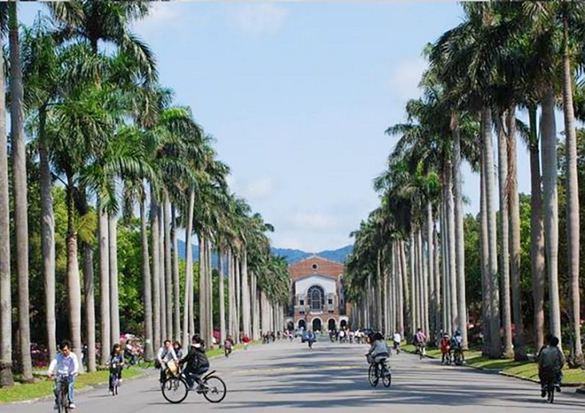



Slide 2
Group 15 – RoboPong
Final Project | Final Presentation | 2019/12/30
National Taiwan University | CSIE5047 – Robotics
Notes:
Bei internen Präsentationen zu „Verein_Titelfolie“ wechseln.

Slide 3




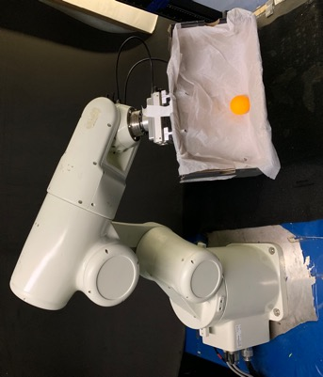

Project Overview – Catching Pong Balls with ITRI Arm
Jakob Ketterer Karlsruhe Institute of
Technology
Iris Andrussow
Karlsruhe Institute of Technology
Clarissa Hamann
Technical University Munich
Gregor Lied Karlsruhe Institute of Technology
Software Problems
Robot-Camera calibration
Recognition of the ball and calculation of the ball trajectory
Connecting camera computer to robot computer via TCP
Inverse Kinematics for movement of robot to the calculated ball catching point
Hardware Problems
Maximum robot speed could limit catching abilities
Group 15 – RoboPong | Final Presentation | CSIE5047 – Robotics | 2019/11/18
Notes:
3

Slide 4
Demonstration Video
Click me to start YouTube Video
Group 15 – RoboPong | Final Presentation | CSIE5047 – Robotics | 2019/11/18

Slide 5
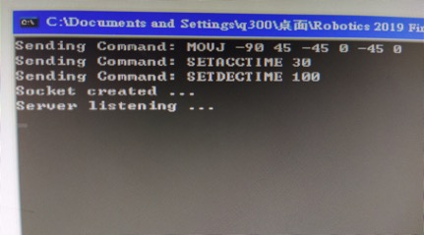
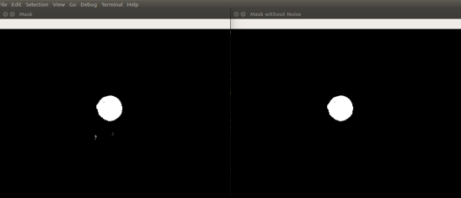
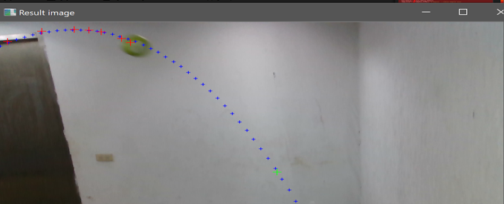
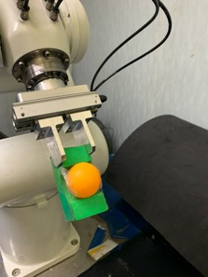
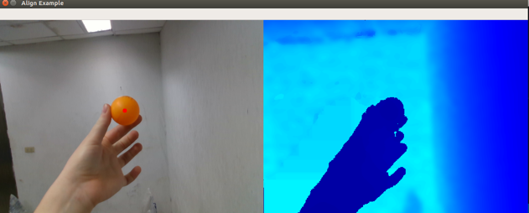
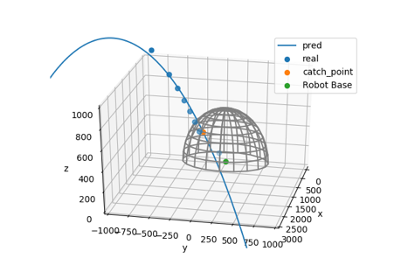

Catching Pong Balls with ITRI Arm - Subtasks
TCP – Connection
3D Robot-Camera Calibration
Ball Detection
Ball Trajectory Estimation
Robot Movement
x
x
x
x
x
x
x
x
Group 15 – RoboPong | Final Presentation | CSIE5047 – Robotics | 2019/11/18

Slide 6
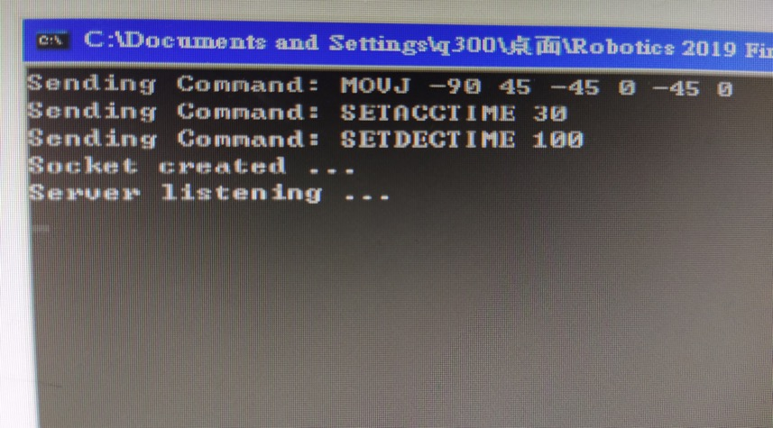
Catching Pong Balls with ITRI Arm - Subtasks
TCP – Connection
3D Robot-Camera Calibration
Ball Detection
Ball Trajectory Estimation
Robot Movement
Group 15 – RoboPong | Final Presentation | CSIE5047 – Robotics | 2019/11/18

Slide 7
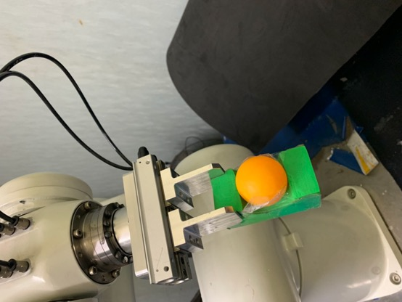
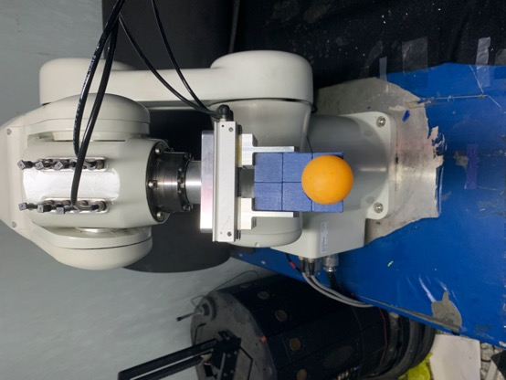
Catching Pong Balls with ITRI Arm - Subtasks
TCP – Connection
3D Robot-Camera Calibration
Ball Detection
Ball Trajectory Estimation
Robot Movement
Group 15 – RoboPong | Final Presentation | CSIE5047 – Robotics | 2019/11/18

Slide 8
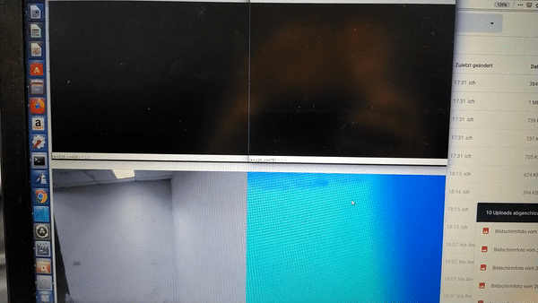


Catching Pong Balls with ITRI Arm - Subtasks
TCP – Connection
3D Robot-Camera Calibration
Ball Detection
Ball Trajectory Estimation
Robot Movement
Group 15 – RoboPong | Final Presentation | CSIE5047 – Robotics | 2019/11/18

Slide 9

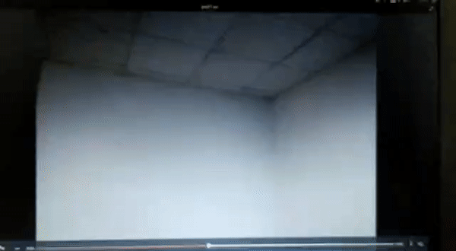
Catching Pong Balls with ITRI Arm - Subtasks
TCP – Connection
3D Robot-Camera Calibration
Ball Detection
Ball Trajectory Estimation
Robot Movement
Group 15 – RoboPong | Final Presentation | CSIE5047 – Robotics | 2019/11/18

Slide 10

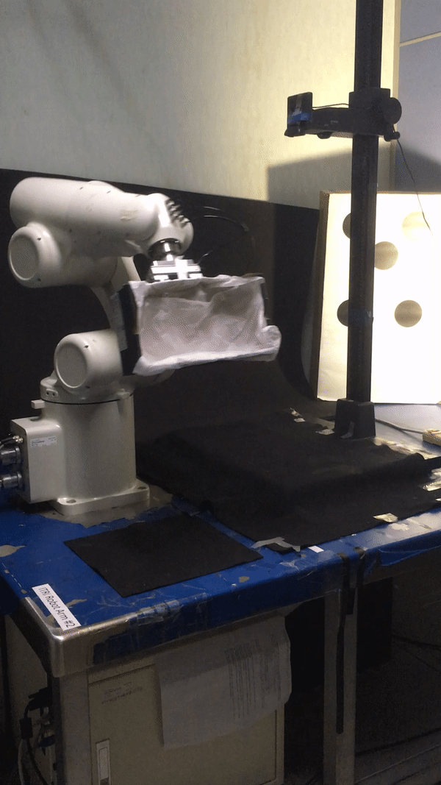
Catching Pong Balls with ITRI Arm - Subtasks
TCP – Connection
3D Robot-Camera Calibration
Ball Detection
Ball Trajectory Estimation
Robot Movement
Group 15 – RoboPong | Final Presentation | CSIE5047 – Robotics | 2019/11/18

Slide 11
We are looking forward to your questions!
Jakob Ketterer Karlsruhe Institute of Technology
Iris Andrussow Karlsruhe Institute of Technology
Clarissa Hamann Technical University Munich
Gregor Lied Karlsruhe Institute of Technology

